Slide 1



Dashboard Airline Flight - Lab 06
View in Power BI
Last data refresh:
3/10/2024 3:02:59 PM UTC
Downloaded at:
3/10/2024 4:04:49 PM UTC

Slide 2
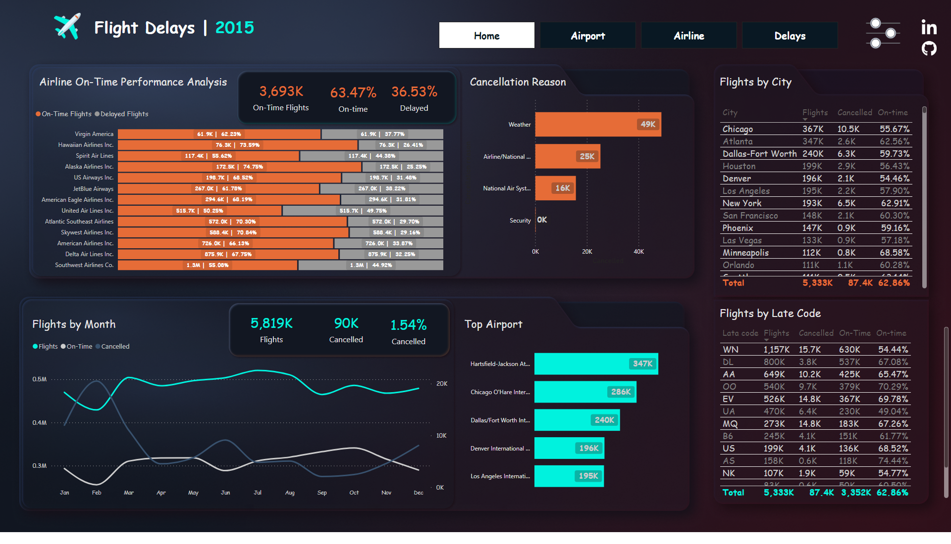
Home
Notes:
card
No alt text provided
card
No alt text provided
card
No alt text provided
card
No alt text provided
clusteredBarChart
No alt text provided
clusteredBarChart
No alt text provided
actionButton
No alt text provided
actionButton
No alt text provided
lineChart
No alt text provided
hundredPercentStackedBarChart
No alt text provided
actionButton
No alt text provided
clusteredBarChart
No alt text provided
actionButton
No alt text provided
textbox
No alt text provided
textbox
No alt text provided
Cancellation Reason
No alt text provided
textbox
No alt text provided
tableEx
No alt text provided
tableEx
No alt text provided
textbox
No alt text provided
textbox
No alt text provided
card
No alt text provided
card
No alt text provided
textbox
No alt text provided
image
No alt text provided
image
No alt text provided
image
No alt text provided
textbox
No alt text provided
pageNavigator
No alt text provided
textbox
No alt text provided
slicer
No alt text provided
slicer
No alt text provided
slicer
No alt text provided
slicer
No alt text provided
slicer
No alt text provided
slicer
No alt text provided
image
No alt text provided
image
No alt text provided
image
No alt text provided
image
No alt text provided

Slide 3
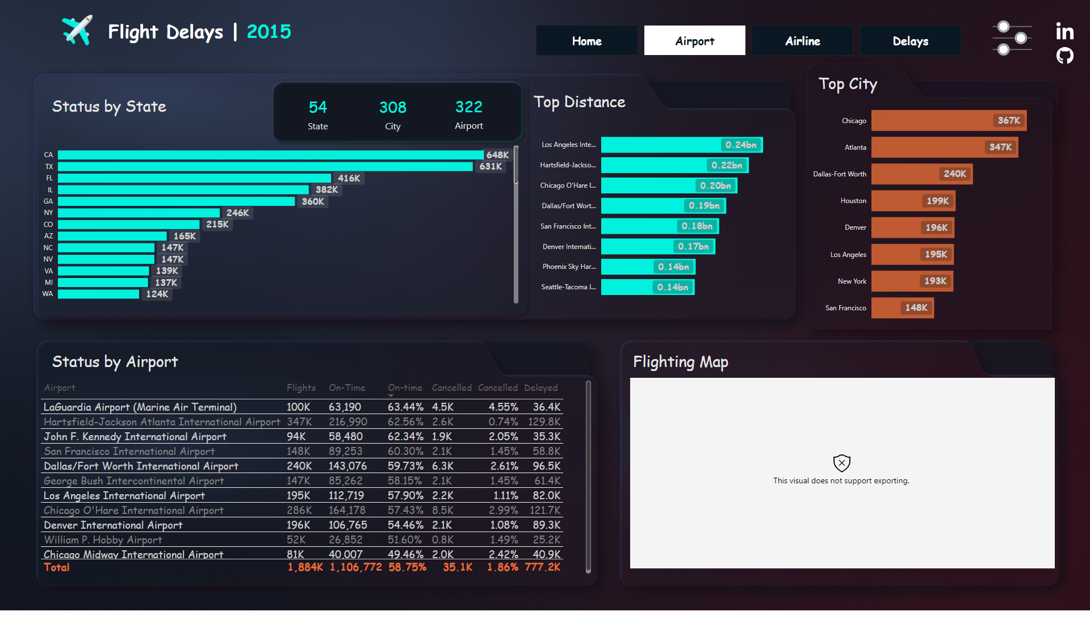
Airport
Notes:
clusteredBarChart
No alt text provided
clusteredBarChart
No alt text provided
Average Departure, Arrival, and Weather Delays by Month
No alt text provided
esriVisual
No alt text provided
card
No alt text provided
card
No alt text provided
tableEx
No alt text provided
textbox
No alt text provided
textbox
No alt text provided
card
No alt text provided
textbox
No alt text provided
textbox
No alt text provided
textbox
No alt text provided
image
No alt text provided
image
No alt text provided
image
No alt text provided
pageNavigator
No alt text provided
textbox
No alt text provided
image
No alt text provided

Slide 4
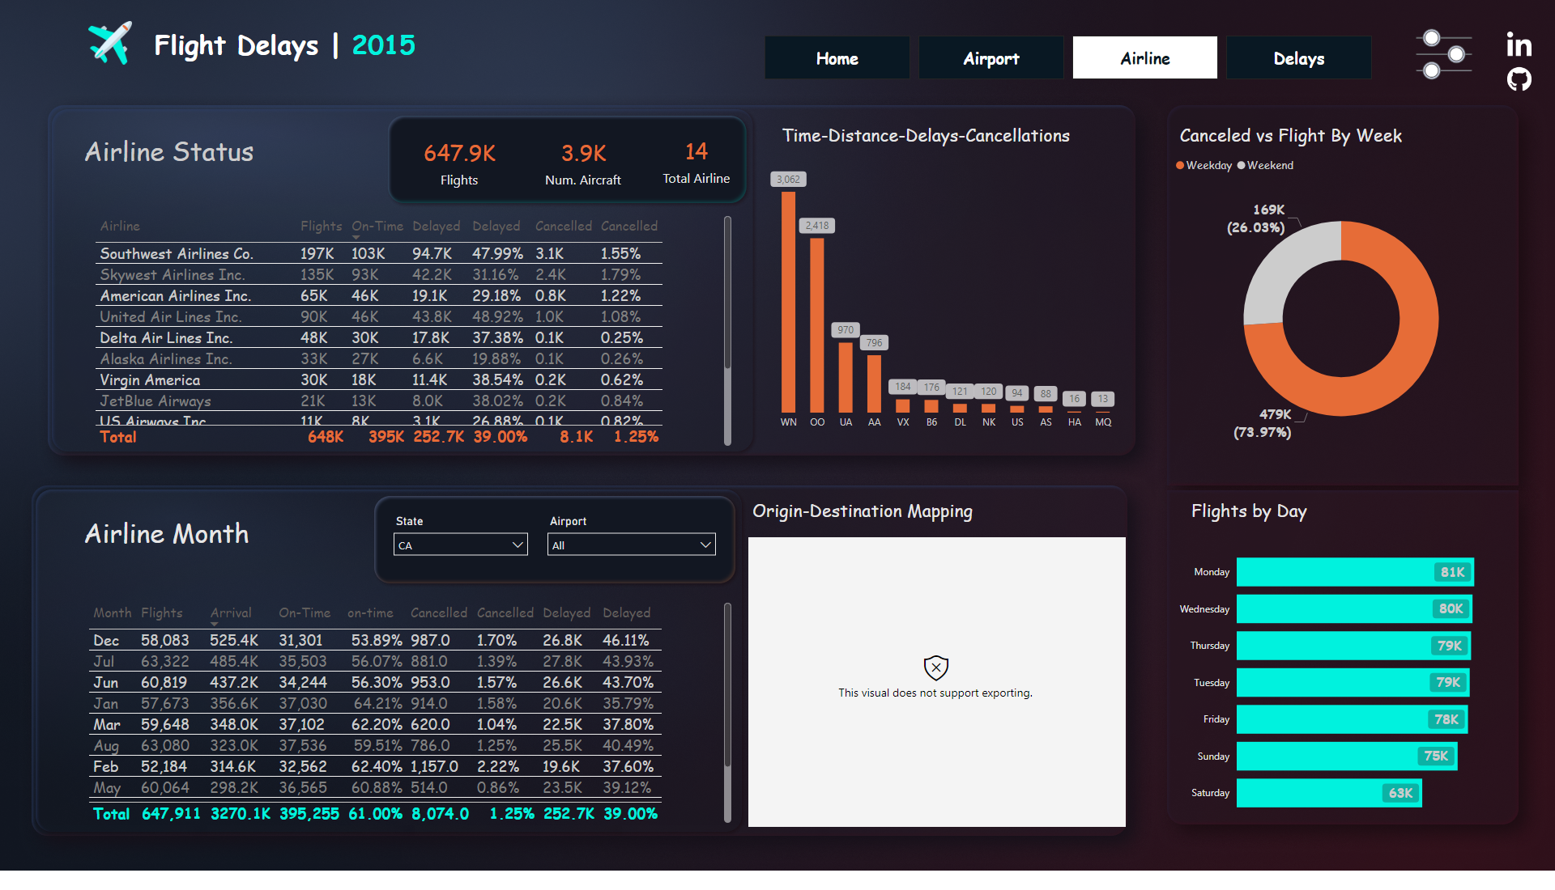
Airline
Notes:
slicer
No alt text provided
slicer
No alt text provided
flowmap30CFDD5B92F848C88242B1E81C8C33C7
No alt text provided
card
No alt text provided
Flights by Day
No alt text provided
Relationship Between Time, Distance, Delays and Cancellations
No alt text provided
card
No alt text provided
card
No alt text provided
Flights & Cancelled by Week
No alt text provided
tableEx
No alt text provided
tableEx
No alt text provided
textbox
No alt text provided
textbox
No alt text provided
textbox
No alt text provided
textbox
No alt text provided
textbox
No alt text provided
textbox
No alt text provided
image
No alt text provided
image
No alt text provided
image
No alt text provided
pageNavigator
No alt text provided
textbox
No alt text provided
image
No alt text provided

Slide 5
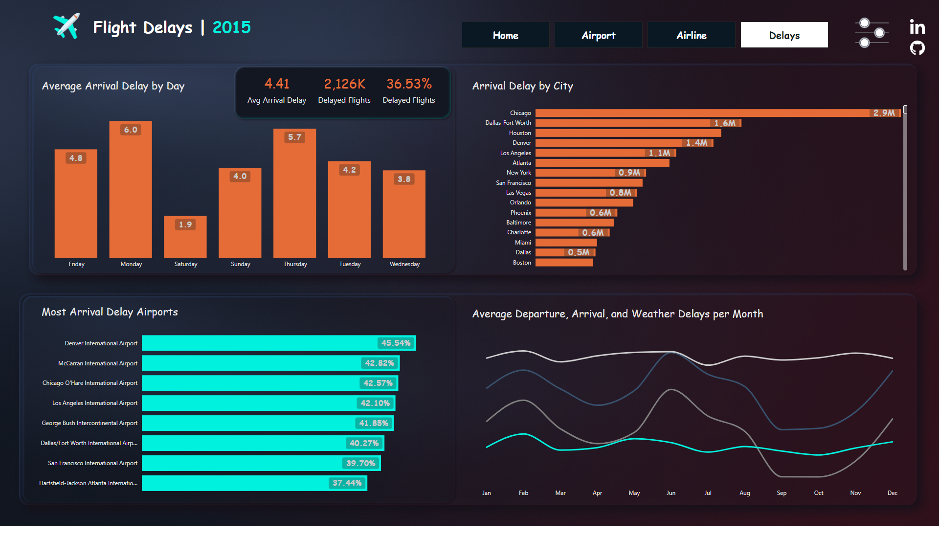
Delays
Notes:
clusteredBarChart
No alt text provided
Avg Arrival Delay by Day
No alt text provided
Average Departure, Arrival, and Weather Delays by Month
No alt text provided
Arrival_delay by City
No alt text provided
card
No alt text provided
card
No alt text provided
card
No alt text provided
textbox
No alt text provided
textbox
No alt text provided
textbox
No alt text provided
textbox
No alt text provided
image
No alt text provided
image
No alt text provided
image
No alt text provided
pageNavigator
No alt text provided
textbox
No alt text provided
image
No alt text provided

Slide 6
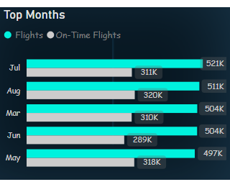
Tooltap Airport
Notes:
Top Months
No alt text provided

Slide 7
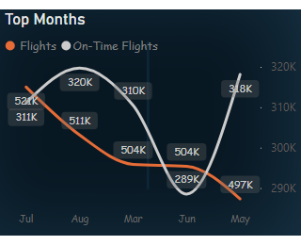
Tooltap top month
Notes:
Top Months
No alt text provided

Slide 8
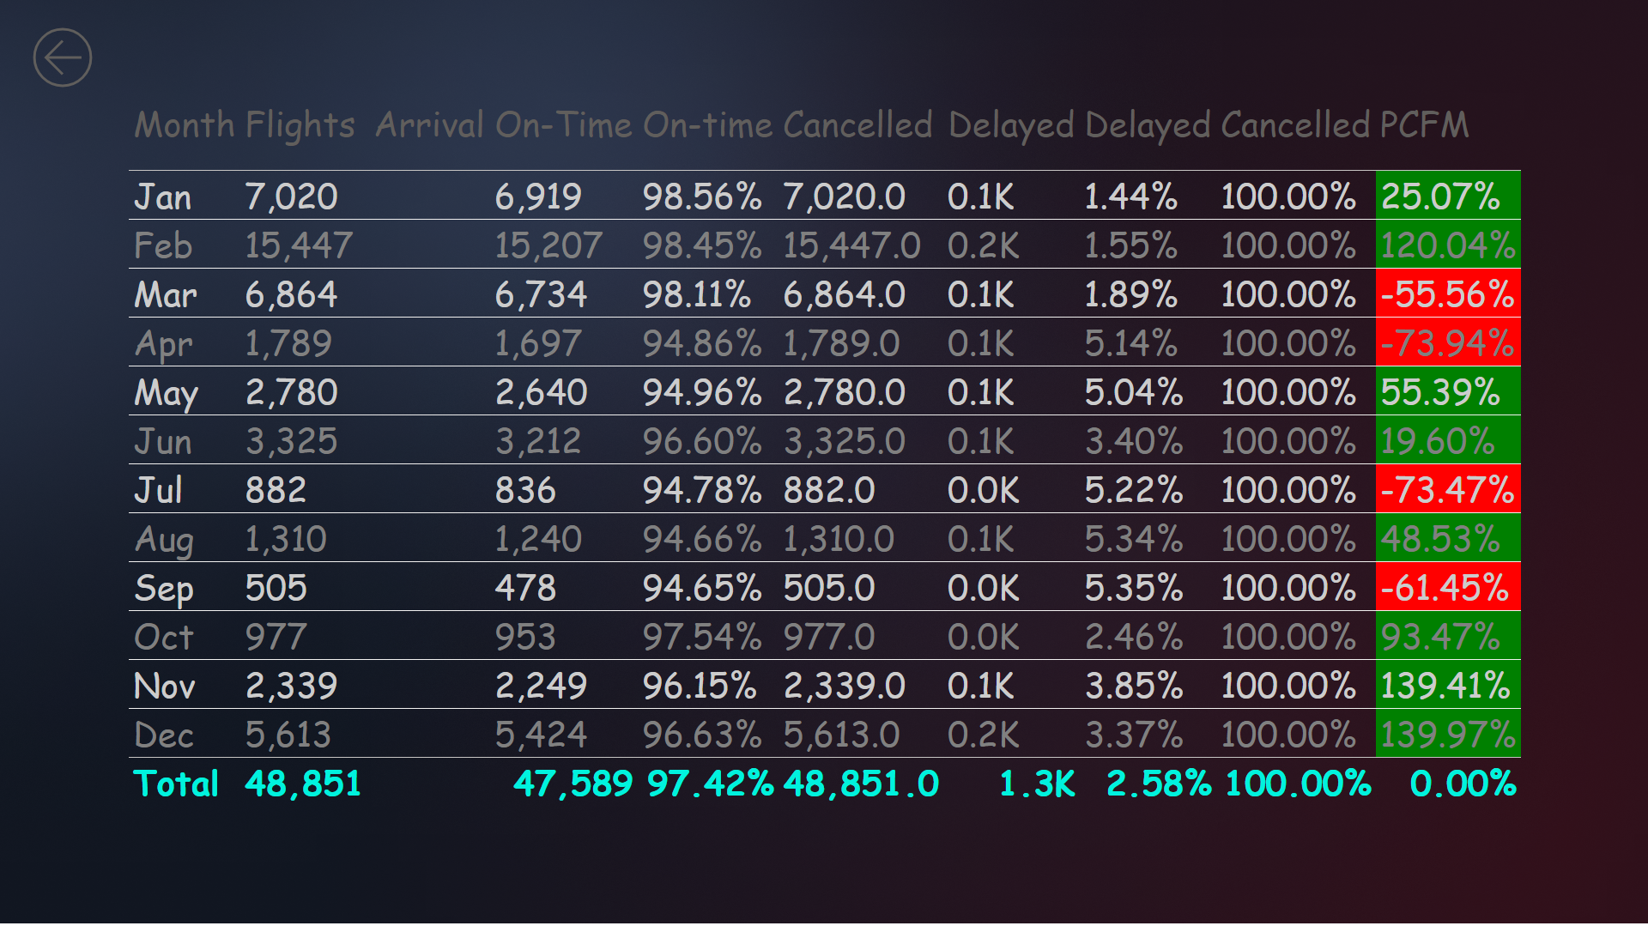
Through Month
Notes:
tableEx
No alt text provided
actionButton
No alt text provided

